Slide 1
How can scientifically minded people believe in miracles?
Micah J. Green
Christian Engineering Leaders
Texas A&M University Sep 24 2018

Slide 2
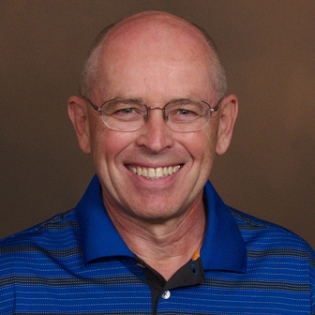
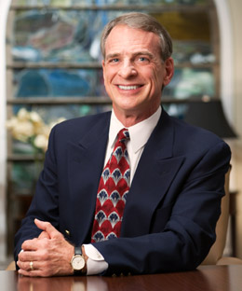
Our goals for today
What is a miracle? Does science disprove miracles?
What’s the purpose of miracles in the Bible?
Should we pray for miracles?

Slide 3
What is a miracle? Does science disprove miracles?

Slide 4
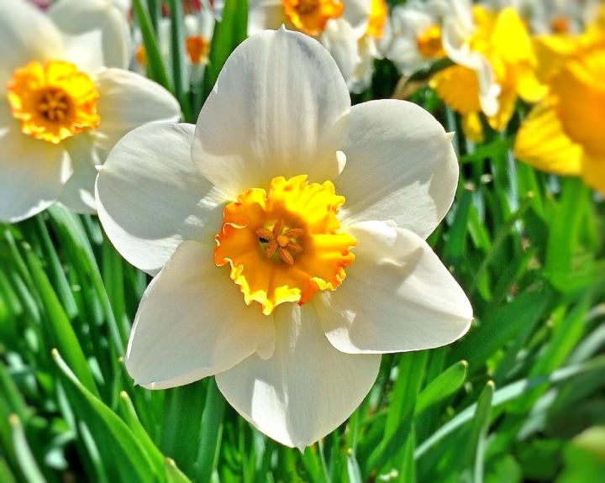
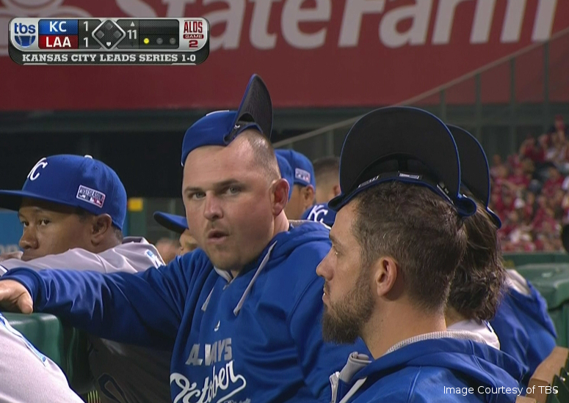
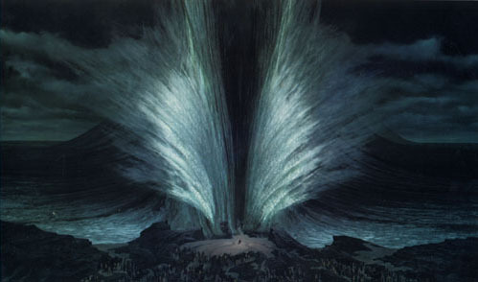
What kind of things do you hear referred to as “miracles”? “It’s a miracle!”

Slide 5
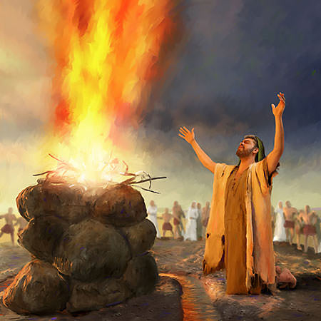
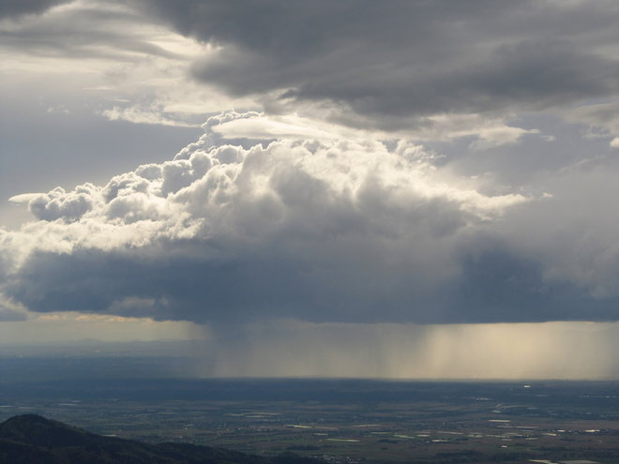
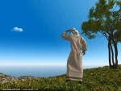
Categories to distinguish miracles
Natural Causes
Special Providence
Miracle
A miracle lies outside the productive capacity of the natural world.

Slide 6
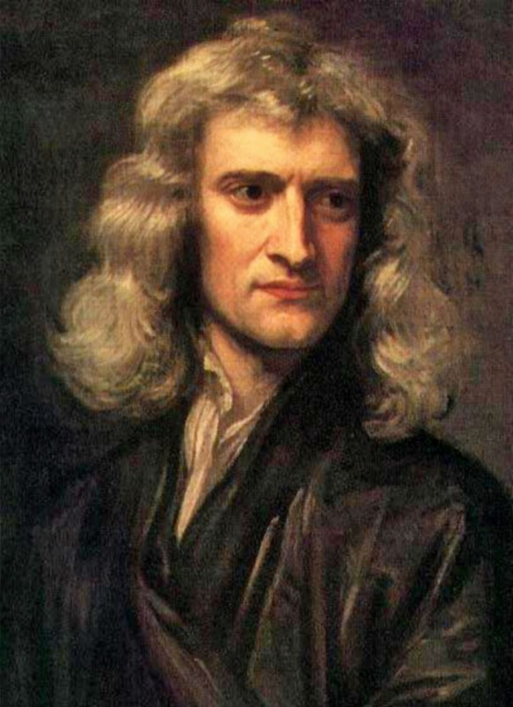
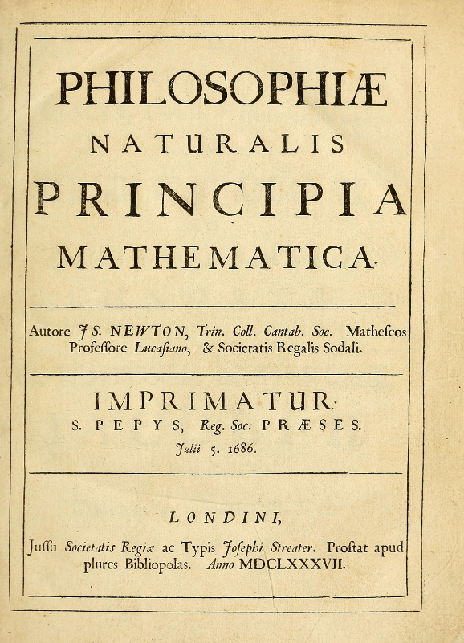
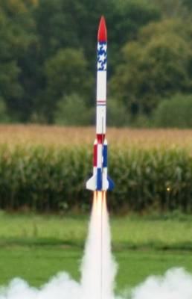
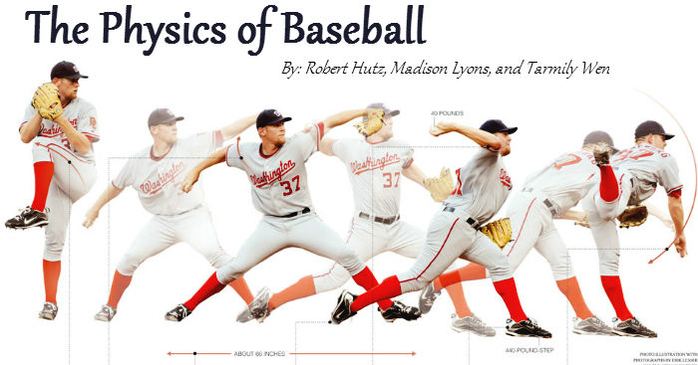
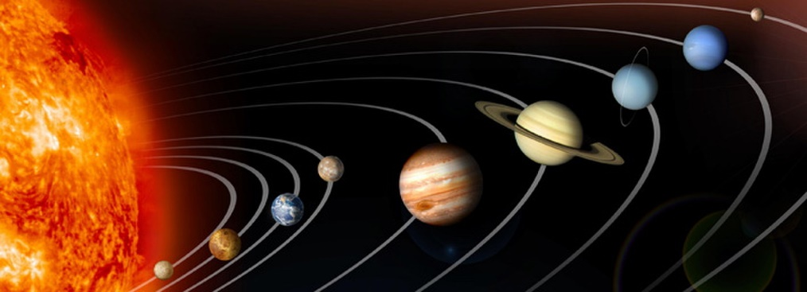
The success of Newtonian Physics
These equations can predict the motion of everything!

Slide 7
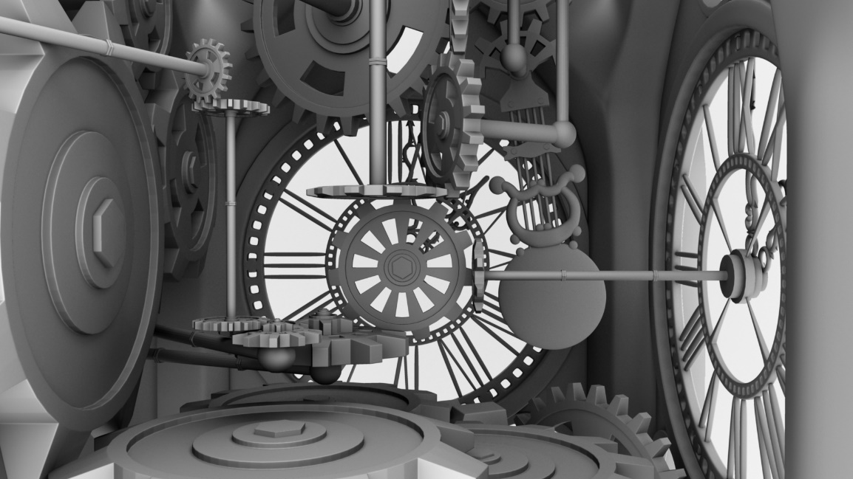
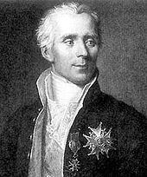
“The world is a clock (that doesn’t need interventions!)”
Deism
Laplace
“la machine du monde”
“Je n'ai pas eu besoin de cette hypothèse.”
“I have no need of that hypothesis”
What hypothesis? Divine intervention

Slide 8
The challenge to miracles
Natural Causes
Special Providence
Miracle
Yes!
Ok…
No way

Slide 9
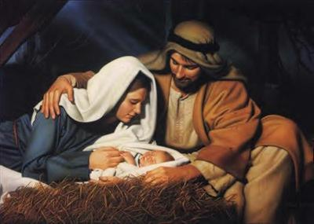
The modern challenge: “Science disproves miracles”
“Ancient people thought that miracles like a virgin birth were possible. Now, thanks to Science, we know it can’t happen.”
Notes:
This assumes that miracles are a violation of the laws of nature.

Slide 10
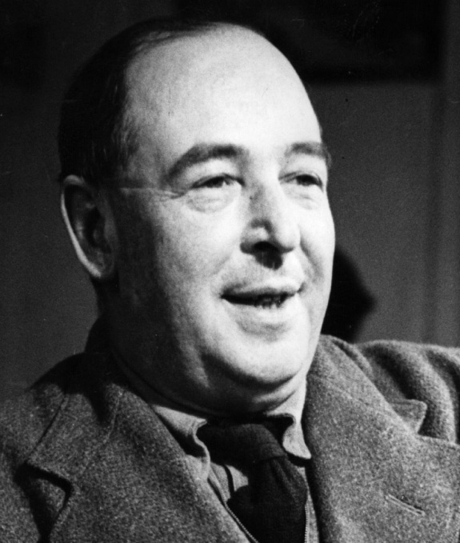
Miracles are not natural, they’re supernatural
Science deals with a description of the natural world; a miracle involves MORE than the natural world.
C. S. Lewis, 1898 –1963

Slide 11
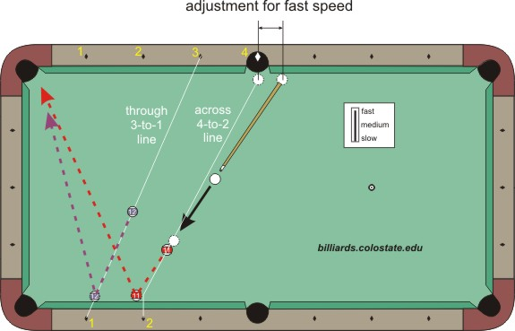
Example: Billiards
Notes:
Example: You play billiards and use science to predict ball’s motion
You hit the cueball….but then I grab it.
Did we disprove science?
Supernatural influences are “outside the table”

Slide 12
The Argument against Miracles
Premise 1: Science (correctly) says that no natural forces can cause a dead person to be resurrected.
Premise 2: There are only natural forces.
Conclusion: A dead person cannot be resurrected.
What?!

Slide 13
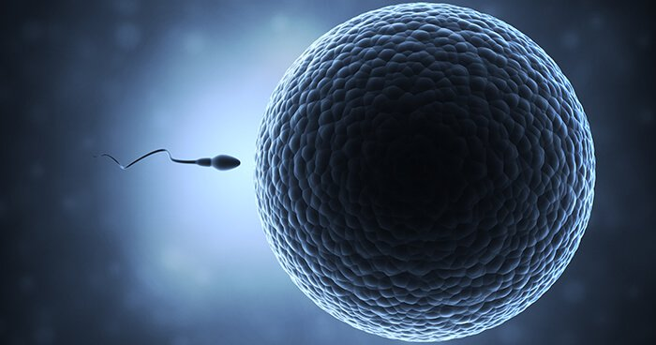
An example
Arthur Peacocke:
Modern cell biology has “radically undermined” the credibility of the virgin birth because it would require God’s making a Y-chromosome out of nothing in Mary’s ovum.
Is this a convincing argument?

Slide 14
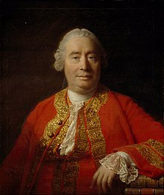
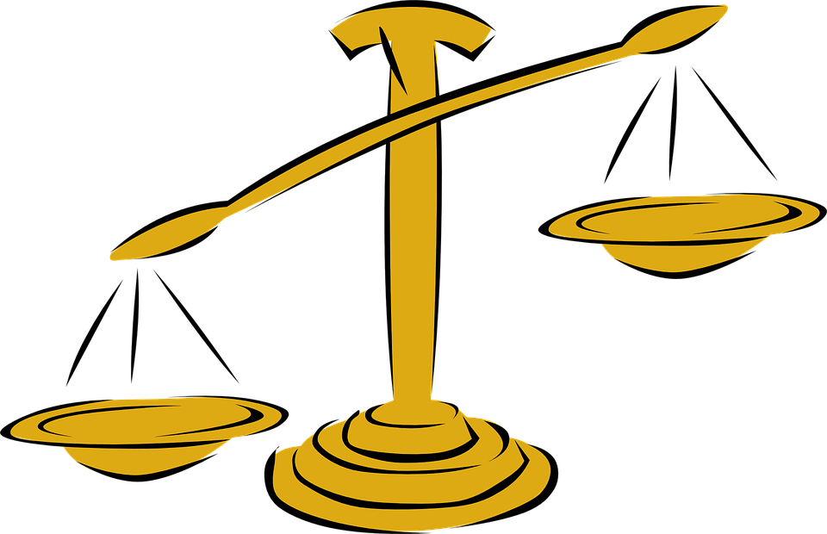
Comprehension check:
Hume: But aren’t miracles inherently improbable?
Hume: “We have TONS of evidence of nature working normally, so your so-called miracle claim is statistically unlikely.”
What’s wrong with this line of thinking?
Note connection to “Higher Criticism”

Slide 15
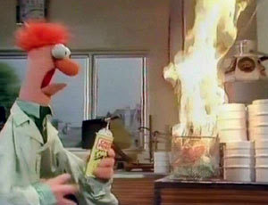
Don’t we have to assume that miracles are impossible in order to do science?
Notes:
That wasn’t supposed to happen!!! Um…it’s a miracle!

Slide 16
Don’t we have to assume that miracles are impossible in order to do science?
No, Miracles are not random; God is going to capriciously mess up your experiment.
Miracles have a religious context.
Notes:
Why do we get to do science at all?

Slide 17
Maybe we’re wrong to talk about “what nature can do on its own”
It’s wrong to think of God as outside the system, only occasionally reaching in.
The truth is that God is the sustainer of the universe; it’s by His will that every little atom continues to act in a regular, predictable way.
Heb 1:3. Christ is “upholding the universe by his word of power.”
Acts 17:28. “In him, we live and move and have our being.”
This is why science is possible!
Notes:
Too wordy

Slide 18
A corrective to the Deists: Providence
Natural Causes
God’s providential ordering & sustaining of the natural world
Special Providence
Miracle
Matt 5:45 “He causes his sun to rise on the evil and the good, and sends rain on the righteous and the unrighteous.”

Slide 19
Summary of Part 1
Science doesn’t disprove miracles: Miracles are not violations of scientific law; it’s the supernatural reaching in.
Miracles don’t happen randomly; they happen for a reason.
God is not distant from the world; he is sovereign over the natural world, and he has the ability to act miraculously in it.

Slide 20
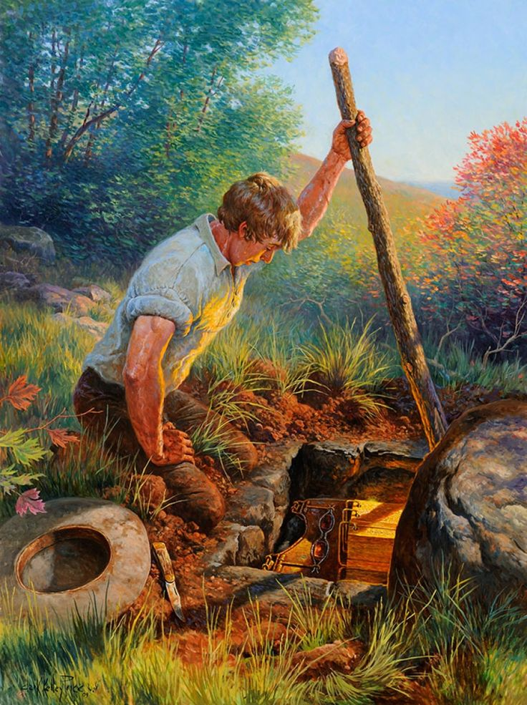
30-second discussion with each other
Hume’s second problem:
Why are you so quick to believe Jesus’ resurrection and so skeptical about miracle claims from other religions?
How would you respond?
Notes:
1. Jesus died by crucifixion.
2. He was buried.
3. His death caused the disciples to despair and lose hope.
4. The tomb was empty (the most contested).
5. The disciples had experiences which they believed were literal appearances of the risen Jesus (the most important proof).
6. The disciples were transformed from doubters to bold proclaimers.
7. The resurrection was the central message.
8. They preached the message of Jesus’ resurrection in Jerusalem.
9. The Church was born and grew.
10. Orthodox Jews who believed in Christ made Sunday their primary day of worship.
11. James was converted to the faith when he saw the resurrected Jesus (James was a family skeptic).
12. Paul was converted to the faith (Paul was an outsider skeptic).
http://www3.telus.net/trbrooks/garyhabermas.htm

Slide 21
Miracles in the Bible

Slide 22
1-minute discussion with each other
A 7-year-old child in your church asks, “If Jesus had the ability to heal people, why didn’t he set up a huge healing assembly line for all the sick people?”

Slide 23
How does the Bible describe miracles?
“Miracle” (mighty work displaying power) “Signs and wonders” – What do these words mean?
“Has any god ever tried to take for himself one nation out of another nation, by testings, by signs and wonders, by war, by a mighty hand and an outstretched arm, or by great and awesome deeds, like all the things the Lord your God did for you in Egypt before your very eyes?” [Deut 4:34]
“He rescues and he saves; he performs signs and wonders in the heavens and on the earth. He has rescued Daniel from the power of the lions.” [Dan 6:27]
“The apostles performed many signs and wonders among the people. And all the believers used to meet together in Solomon’s Colonnade.” [Acts 5:12]

Slide 24
Authenticating the message
“Nobody has ever heard of opening the eyes of a man born blind. If this man were not from God, he could do nothing.” [John 9:32-33]
“Fellow Israelites, listen to this: Jesus of Nazareth was a man accredited by God to you by miracles, wonders and signs, which God did among you through him, as you yourselves know.” [Acts 2:22]
“When the crowds heard Philip and saw the signs he performed, they all paid close attention to what he said.” [Acts 6:8]
“I persevered in demonstrating among you the marks of a true apostle, including signs, wonders and miracles.” [2 Cor 12:12]

Slide 25
Purposes of Miracles
Authenticate the message of the gospel
Bear witness to the coming of the Kingdom of God
Help those in need
Remove hindrance to people’s ministries
Bring glory to God
- Wayne Grudem

Slide 26
A better definition of a miracle
“A miracle is a less common kind of God’s activity in which he arouses people’s awe and wonder and bears witness to himself.” – Wayne Grudem (adapted from John Frame)

Slide 27
Is it bad to pray for a miracle?
It depends on the purpose for which miracles are sought.
“A wicked and adulterous generation looks for a sign, but none will be given it except the sign of Jonah.” Jesus then left them and went away.” [Matt 16:4]
Good reasons
To see God glorified
To confirm the message of the gospel
To see people healed & helped
Bad reasons
To test God
To feel important & be the center of attention
To experience something amazing

Slide 28
What kind of divine action should we pray for?
Does it matter which one of these two we pray for?
God’s providential ordering of the natural world
Special Providence
Miracle
“When an answer to prayer is so remarkable that people involved with it are amazed and acknowledge God’s power at work in an unusual way, then it seems appropriate to call it a miracle.” - Grudem

Slide 29
Points of application
You will have moments when you think, “Do I really believe this miracle stuff? Really?”
That doubt is only a feeling; it’s not an intellectual argument.
Do you pray in faith that God can act in the world and that your prayers are effectual?
Do you track when prayers are answered and attribute it to God?
Notes:
Go from Grudem book here

Slide 31
James 5
¹³ Is anyone among you in trouble? Let them pray. Is anyone happy? Let them sing songs of praise. ¹⁴ Is anyone among you sick? Let them call the elders of the church to pray over them and anoint them with oil in the name of the Lord. ¹⁵ And the prayer offered in faith will make the sick person well; the Lord will raise them up. If they have sinned, they will be forgiven. ¹⁶ Therefore confess your sins to each other and pray for each other so that you may be healed. The prayer of a righteous person is powerful and effective.
¹⁷ Elijah was a human being, even as we are. He prayed earnestly that it would not rain, and it did not rain on the land for three and a half years.¹⁸ Again he prayed, and the heavens gave rain, and the earth produced its crops.

Slide 33
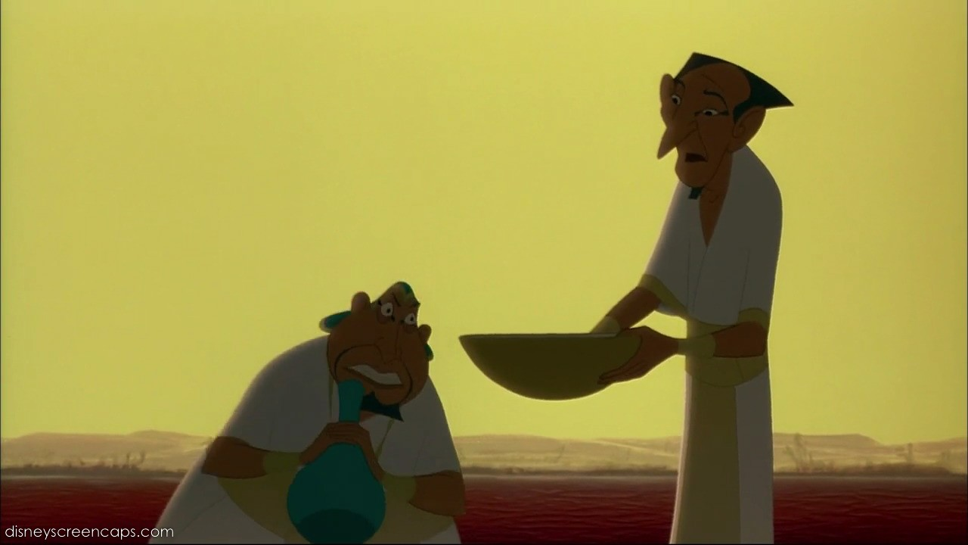
Are false miracles possible?
Pharaoh’s magicians (Exodus 7)
Simon the sorcerer (Acts 8)
Man of Sin will come “with all power and with pretended signs and wonders” (2 Thess 2:9-10)
The second beast will “work great signs” (Revelation 13)
The Biblical emphasis seems to be that false miracles are less powerful than what God can do.
Workers of false miracles deny the gospel; true miracles glorify God & edify God’s people
Notes:
Should we include this?

Slide 34
1-minute discussion with each other
Have you known of any answers to prayer in your own church (or your own life) that you would call miraculous?

Slide 35
Do miracles continue today?
(Honest truth: It’s hard to get a definitive Biblical answer to this!)

Slide 36
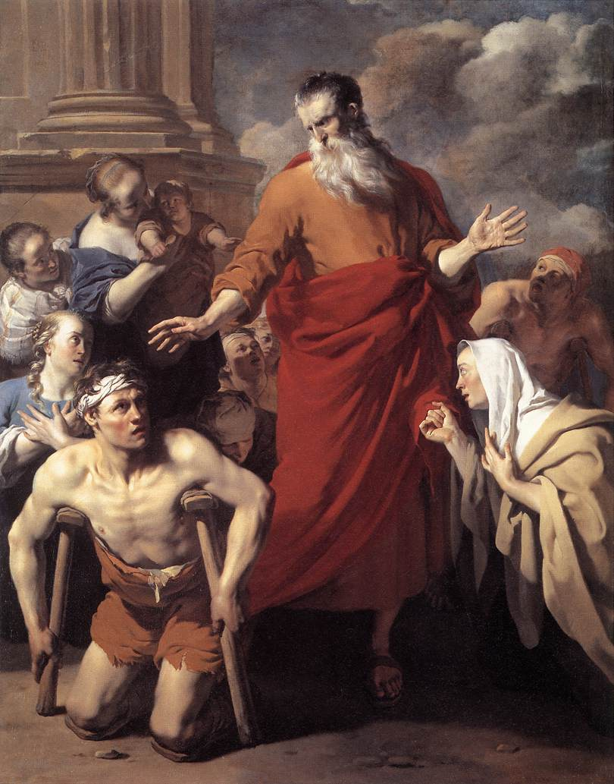
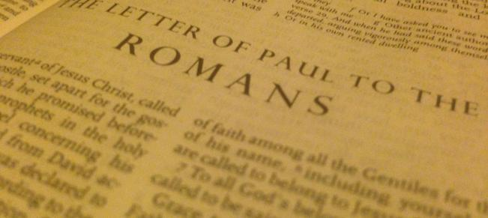
“Cessationism”
Acts 19: ¹¹ God did extraordinary miracles through Paul, ¹² so that even handkerchiefs and aprons that had touched him were taken to the sick, and their illnesses were cured and the evil spirits left them.
Notes:
Miracles [and sign gifts like speaking in tongues] seem to have dropped off at the end of the apostolic age.
Miracles serve to authenticate the message which we now have set down in Scripture.
The writing of Scripture has ceased.
Therefore Miracles have ceased.

Slide 37
Should we expect miracles today?
Cessationism
Miracles have purpose of establishing credibility.
Apostleship ceased.
Apostles were foundational for writing Bible (which has ceased); Bible is sufficient as is.
Thus, miracles have also ceased.
Modern “miracles” do not match New Testament; lots of charlatans
Church history shows huge dropoff in miracles after apostles.
Continuation:
Early church prayed for miracles [Acts 4:29-30]
Miracles in the broader church [Gal 3:5]
Praying for healing [James 5:14]
Can be difficult to distinguish “miracles” from special providential answers to prayer.
Are we sure miracles have stopped?
Notes:
Fix spacing

Slide 38
Miracles are happening today around the world, in some measure. They can happen more when God is pleased to pour out his Spirit. And the reason it's not as normative now as it was in the apostles is because he meant to signify that this point in history, this incarnation, this authoritative band of apostles was unique.
- John Piper

Slide 40
1 minute of discussion:
Someone says, “You believe that miracles are possible? But we all know that science has proven that miracles aren’t possible.” What would you say?

Slide 41
30-second discussion
Miracles seem to be clustered around certain parts of Biblical history: Which ones?

