Slide 1
You Have Everything You Need!
Campus Evangelism

Slide 2
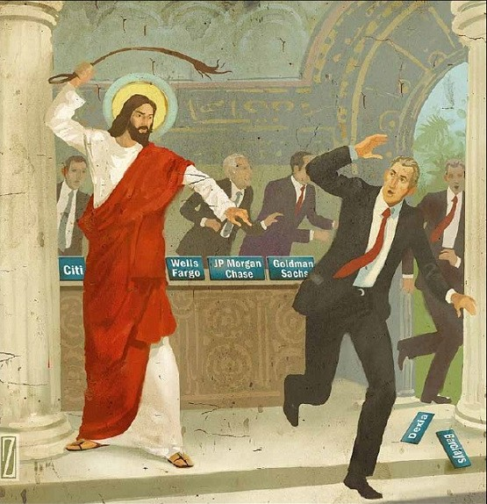
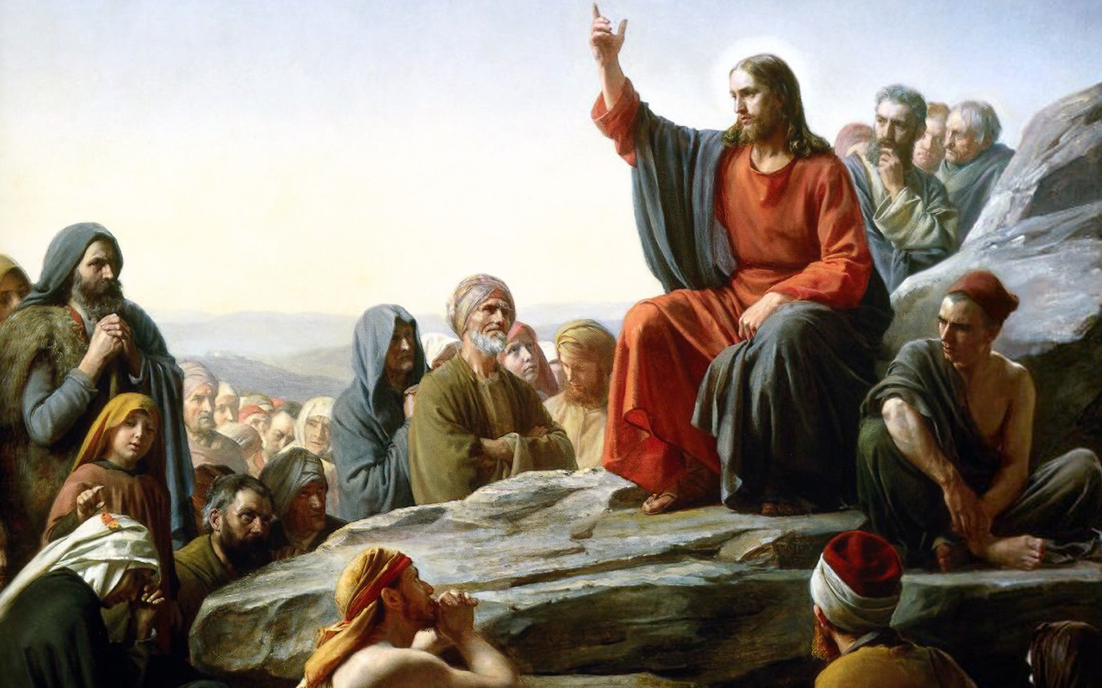
Quick Overview
Evangelize - convert or seek to convert to christianity/ preach the christian gospel
5 Speakers: Our Goals:
Kendell: Defining Success Teach
Nathaniel: Your Story Rebuke
Alex: Your God-given tool box Correct
Sam: Truth and love Encourage
Owen: Overtime all the time

Slide 3
What is our job description?
Ambiguity fuels fear for many people
Conversion ain’t success because conversion ain’t our job

Slide 4
So… what exactly does success look like?
Jesus tells us!
How do we grow the kingdom of God? Mark 4:26-29 has the answer: 5 things: 1) Sower 2) Seed 3) Soil 4) Season 5) Sickle

Slide 5
Practical Applications
My food, said Jesus, “is to do the will of him who sent me and to finish his work. … Thus the saying ‘One sows and another reaps’ is true.” (John 4:34,37)
Define a personal goal for yourself
Any spiritual conversation
=program ended with exit code: 0

Slide 6
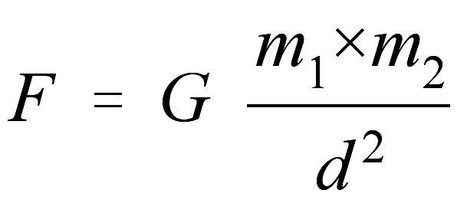
Tell Your Story!
Stories are memorable
Stories change people
Reminders:
Your story is episodic.
Your story is non-debatable!
Your story is relevant!
Your story is powerful!
Notes:
(Nathaniel) OQ:
How many people can remember the universal gravitational constant?
How many people remember the plot line of Avengers: Infinity War
How many people remember Jesus’ parable of the sower?
Story that makes you cry?
Memories that make you laugh?
Others?
Memories that make you cry?
Others?
1 Corinthians 10:13
Samaritan woman

Slide 7
Your God-given Toolbox

Slide 8
Our God-given Toolbox
The Gospel (Romans 1:16)
Use Scripture (Isaiah 55)
Not cutesy sayings like (Acts):
“Jesus loves you.”
“Jesus’ death, burial, resurrection”
Or…
Notes:
I’m going to be talking about the tool kit that has given you when it comes to evangelism. Your primary tool is the Gospel itself. The Gospel is the power of God for salvation. How many of you believe the Gospel? If you believe the Gospel, then congrats you can do evangelism! Evangelism necessitates sharing the Gospel.
Before apologetics, before anything else, know the Gospel!! Two things recently that have helped me more than anything else: seeing the Gospel shared in Acts, and understanding the explanation of the narrative throughout the Old Testament and into the New Testament, and that is the centrality of His glory in His story (History)!! Sharing the Gospel solidifies the Gospel. What helped me understand the Gospel more than anything else was sharing the Gospel almost daily Freshman and Sophomore years on campus. Evangelism helps immensely in crystallizing the Gospel. One of the best things you can do to help you know if you know it is to try to teach it to someone else. Many times I have made connections that I otherwise wouldn’t have made because someone asked me a question or something like that.
The Word of God is your primary weapon! These are the words of God. Your words are great, but the words of God are definitely more powerful than yours!
Ii. The central events of the Gospel but does not describe their significance! Important creed in 1 Corinthians 15 dated within 5 years.

Slide 9
Preach the Gospel at all times. If necessary, use words

Slide 10
Our God-given Toolbox
The Gospel
Not cutesy sayings
Declare the “whole counsel of God” (Acts 20:27)
Resources
American Gospel: Christ Alone
The Explicit Gospel by Matt Chandler

Slide 11
Our God-given Toolbox
The Gospel
Your experiences
Your personality
A tool, not an excuse
Shaped through obedience
Notes:
2. Each person has a unique set of circumstances and experience that will enable you to connect with or help this person overcome obstacles in a unique way. Hard to count the number of times where either my or my partner’s experience aligns with or connects to this person in some random way. I was doing evangelism with my cousin and he connected on a point of homosexual tendancies.
3. Personality allows unique connection and approach to the conversation that your partner might not have. Introversion doesn’t mean you are excused from going and making disciples of all nations.

Slide 12
Our God-given Toolbox
Spiritual gifts
Evangelism is not a spiritual gift
Passion and persuasion
2 Corinthians 5:18-20
“Have you no wish for others to be saved? Then you're not saved yourself, be sure of that!” - Charles Spurgeon
Notes:
4. Spiritual gifts.
5. Spurgeon: “If sinners be damned, at least let them leap to Hell over our dead bodies. And if they perish, let them perish with our arms wrapped about their knees, imploring them to stay. If Hell must be filled, let it be filled in the teeth of our exertions, and let not one go unwarned and unprayed for.”

Slide 13
Truth with love
What is truth with love and how does it relate?
“Truth without love is brutality, and love without truth is hypocrisy.”― Warren Wiersbe
What do we understand love to be?
“Beloved, let us love one another, for love is from God, and whoever loves has been born of God and knows God. Anyone who does not love does not know God, because God is love..”1 John 4:7-8
Who are we called to love?
"On hearing this, Jesus told them, "it is not the healthy who need a doctor, but the sick. I have not come to call the righteous, but sinners.” Mark 2:17
What does this mean?
We’re called to love Everyone
What does truth without Love look like?
“Don’t be a gardening tool” - Jed
“Hell is gonna be the best party ever” - Crowd of Jed
Notes:
Emphasize the idea of getting into debates vs. being open with someone, being interested and asking qhy do you believe that
The role of as a follower of christ, brothers and sisters of christ and unbelievers
Love 1 corinthinas 3 4-7
Proverbs “hidden love”
Faithful are the wounds of a friend, but the enemy heaps up
Jesus says “its not the healthy who need the physician, its the sick”
######################################
What is love?
Secular Cu
•Where as we’re called to love everyone as a child of God.
•1 John 4:7-8 ‘ Beloved, let us love one another, for love is from God, and whoever loves has been born of God and knows God.Anyone who does not know God, …’
•Meet them where they’re at, but you don’t have to agree with everything
What is situation , where we can see this practically
Focus of the evangelism
First and foremost is their relationship w/
Focus: 4 types of love
Desiring the love and what is best for someone
“truth

Slide 14
Overtime all the time
Not just a one time thing
Matthew 28:19
It’s how you live, not something you do
1 Corinthians 9:14
Always be ready
1 Peter 3:15
Be conscious of how you act and how your actions influence others
Be in constant prayer
Philippians 4:6

Slide 15
Concluding Statements
Evangelism
Our Role
Our Purpose
He has fully equipped us
Christ shows us how to balance truth and love
Be honest with yourself!
Remember, you cannot serve two masters

