Slide 1
WHO AM I
RACHEL AUSTIN
FROM HOUSTON, TX
BACHELORS IN MECHANICAL ENGINEERING, CLASS OF ‘19
HOBBIES: SOCCER, ULTIMATE FRISBEE, BOARD GAMES, SOCIAL DANCING

Slide 2
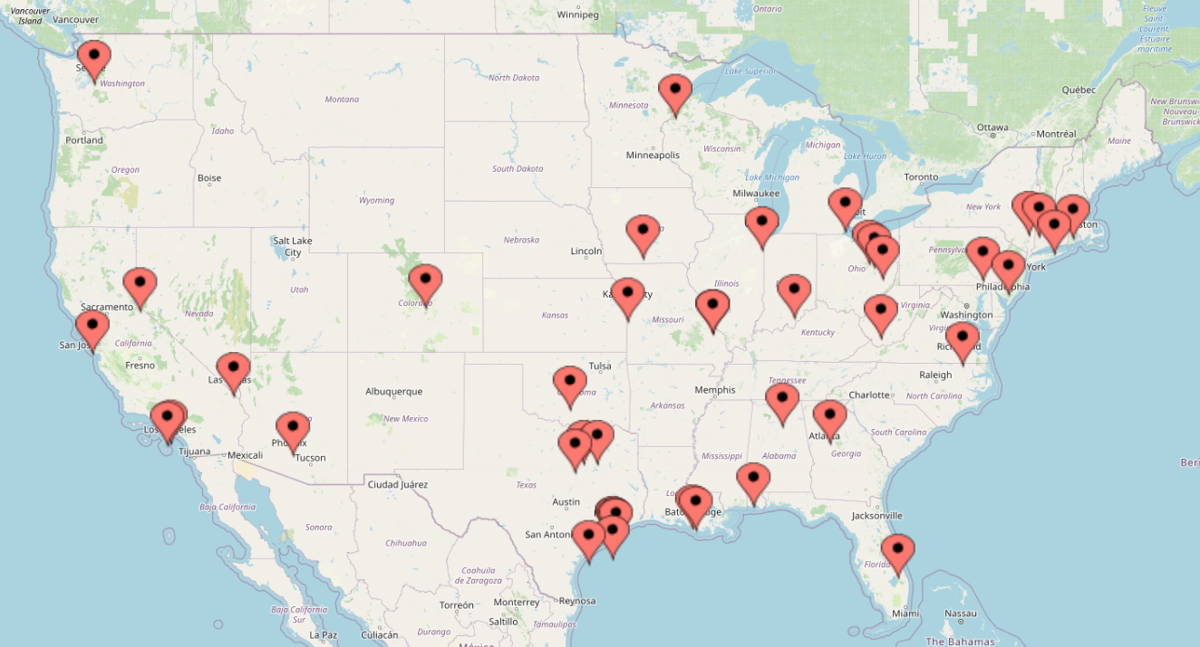
WHERE DID I APPLY

Slide 3
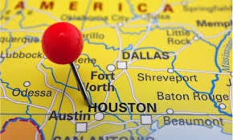
WHERE DID I END UP
APPLIED TO 40+ JOBS
5 WITHIN HOUSTON AREA
ACCEPTED AN OFFER SPRING SEMESTER SENIOR YEAR
MOVED TO PONTIAC, MICHIGAN JULY 2019

Slide 4
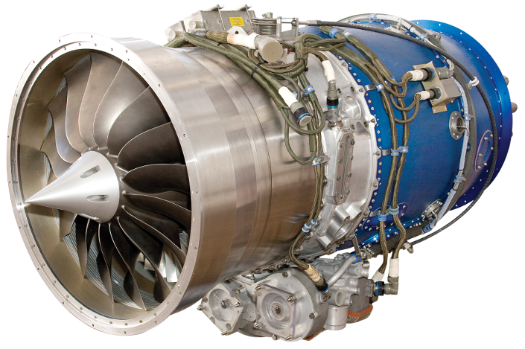
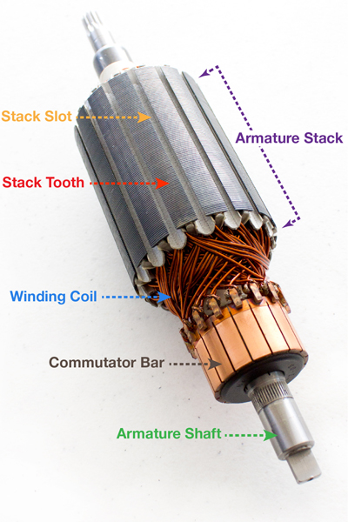
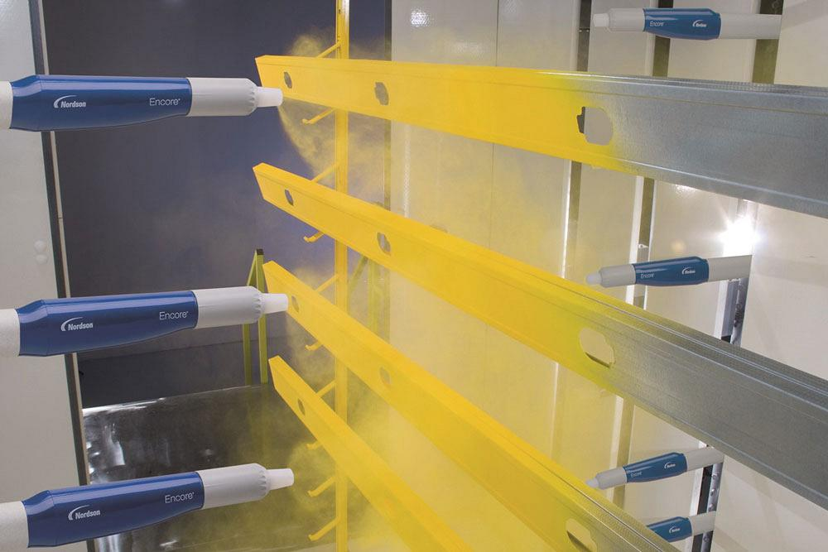
WHAT I DO
MANUFACTURING ENGINEER AT WILLIAMS INTERNATIONAL
ELECTRICAL COMPONENTS AND ASSEMBLY
R&D, PRODUCTION PROCESS IMPROVEMENTS, MATERIAL REVIEW

Slide 5
PRACTICAL TIPS: FIND A CHURCH
DOCTRINAL STATEMENT/ STATEMENT OF BELIEFS
ACTS 29 CHURCH
MULTIGENERATIONAL WITH A YOUNG ADULT PRESENCE
SERVE

Slide 6
PRACTICAL TIPS: GET INVOLVED
JUST GO!
EVENTS WITH COWORKERS
FIND GROUPS FOR YOUR HOBBIES OR JOIN A GROUP TO LEARN A NEW HOBBY
MEETUP APP

Slide 7
EMOTIONAL TIPS
YOU WILL ALWAYS BE LEAVING SOMETHING BEHIND. KEEP GOING.
BEING ALONE IS NOT THE SAME AS BEING LONELY.
CALL HOME. CALL YOUR FRIENDS.
DON’T BE AFRAID TO INITIATE.

Slide 8
DISCLAIMERS

Slide 9
GREATER DISTANCE $≠$ GREATER DIFFICULTY

Slide 10
EACH OPPORTUNITY LEADS TO DIFFERENT OUTCOMES

Slide 11
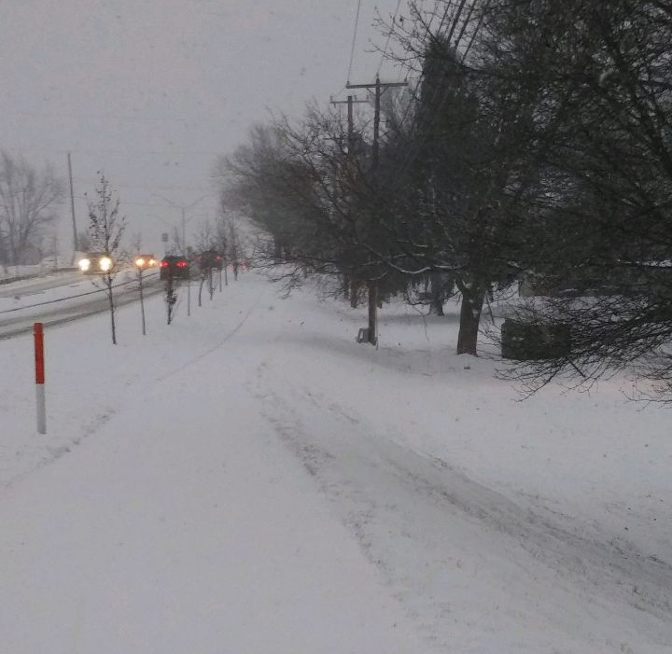
OOPS, I DIDN’T KNOW THAT
THE SECULAR BUBBLE CAN BE DISCOURAGING.
SOUTHERN HOSPITALITY IS REAL.
BUY A SHOVEL.

Slide 12
REACH OUT! RACHEL AUSTIN (281) 610-7060 raustin@williams-int.com rmaustin21@gmail.com

