Slide 1
When Jesus is Your Plan A You Don’t Need Plan B
Dr. Chris Alexander, PE
Texas A&M Christian Engineering Leaders| Monday, October 15, 2018

Slide 2
Today’s Discussion
My background
Opportunities in engineering
Consulting engineering
What’s involved
Case studies
Career suggestions
Integrating Jesus into every aspect your life

Slide 3
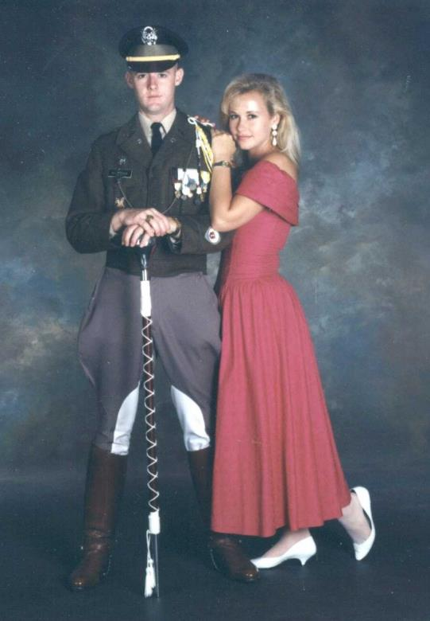
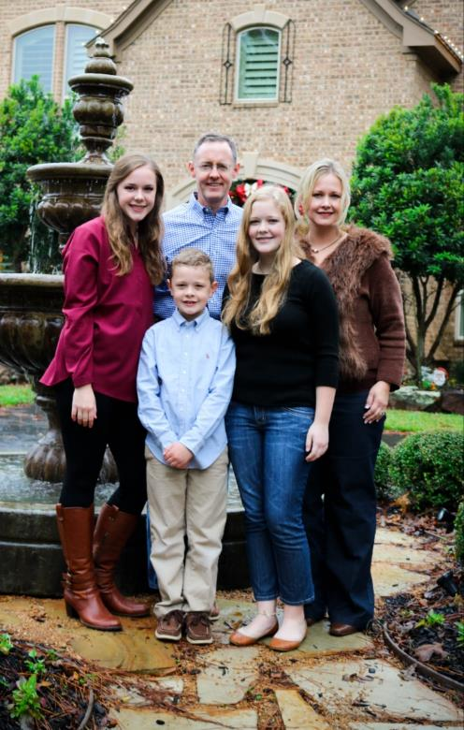
THEN and NOW

Slide 4
My Background
B.S. (1991), M.S. (1993), and Ph.D. (2007) degrees in Mechanical Engineering from A&M
Stress Engineering Services, Inc. (1993 to 2017)
International travel associated with engineering/business problem solving
Numerous technical presentations and technical papers
New ventures started summer of 2017:
IDT EXPO.com
ADV Integrity, Inc.

Slide 5
Opportunities in Engineering
Problem solvers – know the fundamentals
Design opportunities, especially advanced materials and communication technologies (similar to 1940’s aviation industry)
Energy (oil and gas) industry flush with opportunities
New frontiers (high pressure and high temperature)
Keeping the “old stuff” running
Dealing with increased regulations
Need for engineers with advanced degrees and effective communication skills

Slide 6
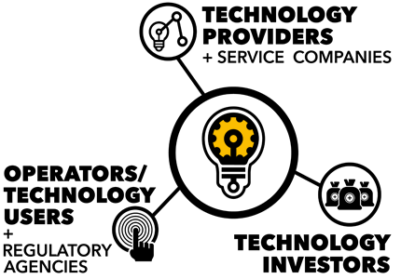
Integrating Faith and Work

Slide 7
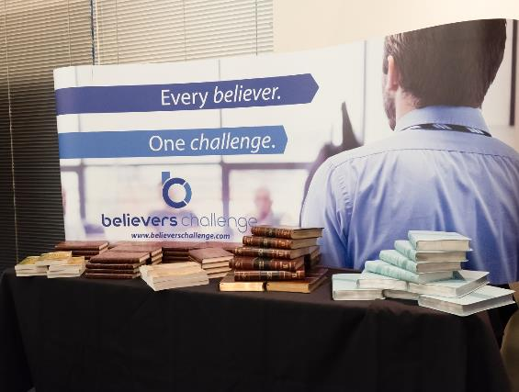
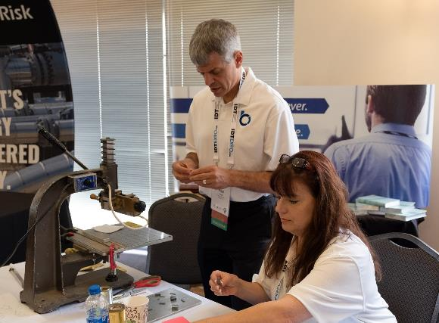
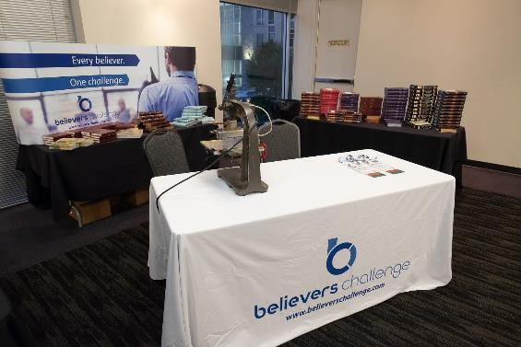
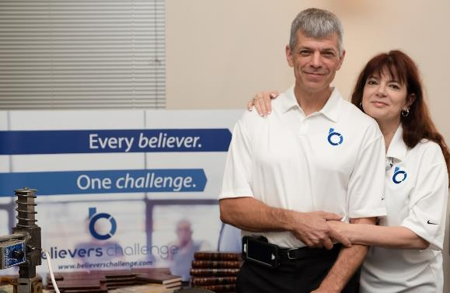
Integrating Faith and Work

Slide 8
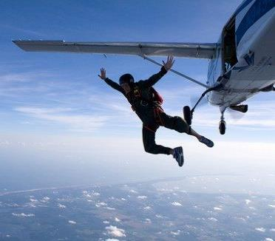
Taking Risks (Quotes for the Day!)
God’s desire is that we be involved in pursuits that are destined to fail without His involvement.
What you are willing to give up often determines what you are able to achieve.
If you don’t take risks, you’ll always work for someone who will.

Slide 9
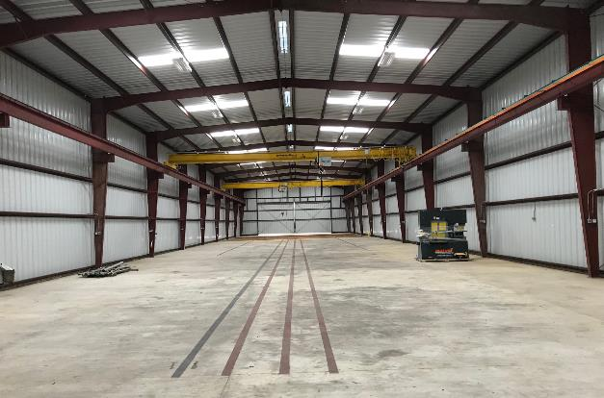
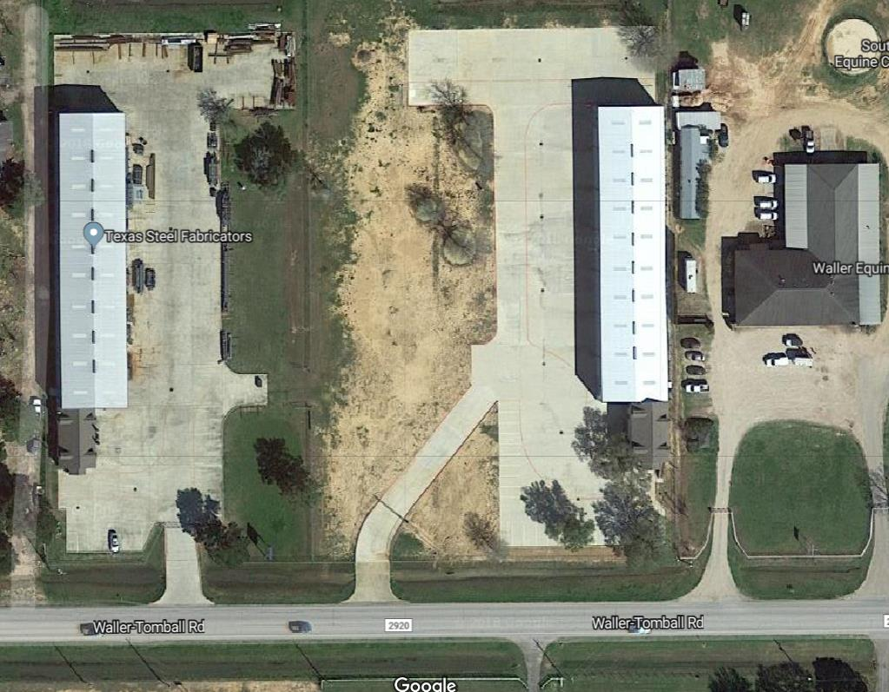
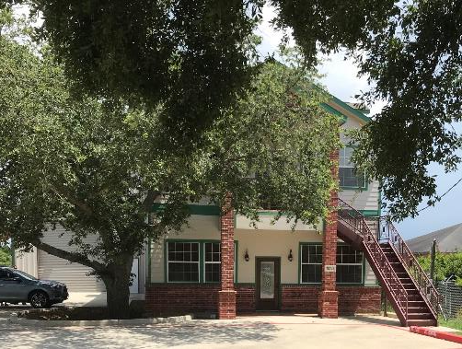
28306 FM 2920 | Waller, Texas 77484

Slide 10
Career Thoughts

Slide 11
The Career Progression
Sole Contributor
Accomplish through Others
Accomplish through Vision

Slide 12
The “Three S’s”
Stature
Style
Substance
Substance: What you know
Style: How you interact with others
Stature: Your credibility in the marketplace

Slide 13
Relationships are the key…
Take the test – 5voices.com

Slide 14
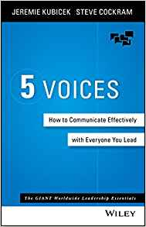
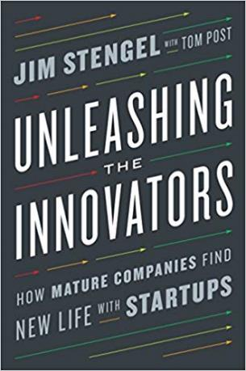
Become a Voracious Reader

Slide 15
Career Suggestions
Consider going to graduate school (at least consider getting a Masters)
Build a SUPER STRONG network
Find mentors early in your career
Take (calculated) risks!!!
Treat life like an experiment…
Have fun (i.e. make it fun) – life is too short to not be fun
www.bethebeans.com

Slide 16
Making Jesus “Plan A”

Slide 17
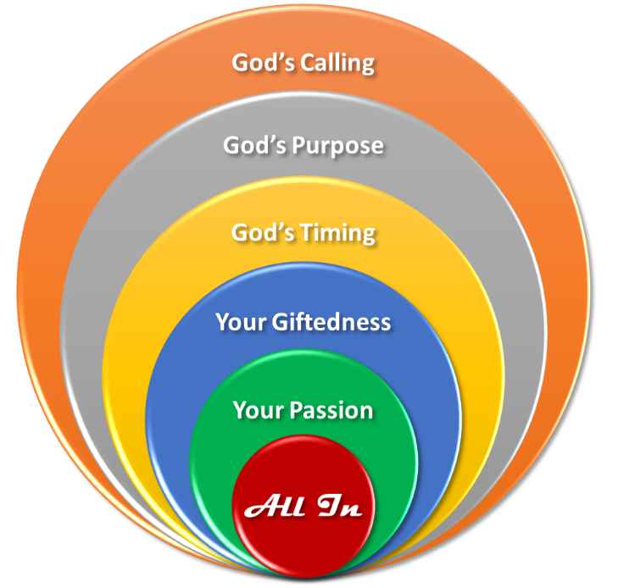
Being All In for Jesus
It’s easy to “coast through” life (especially when you get older!)
Being a committed Believer takes work (similar to staying in shape physically)
Don’t ever forsake your passions and things you enjoy

Slide 18
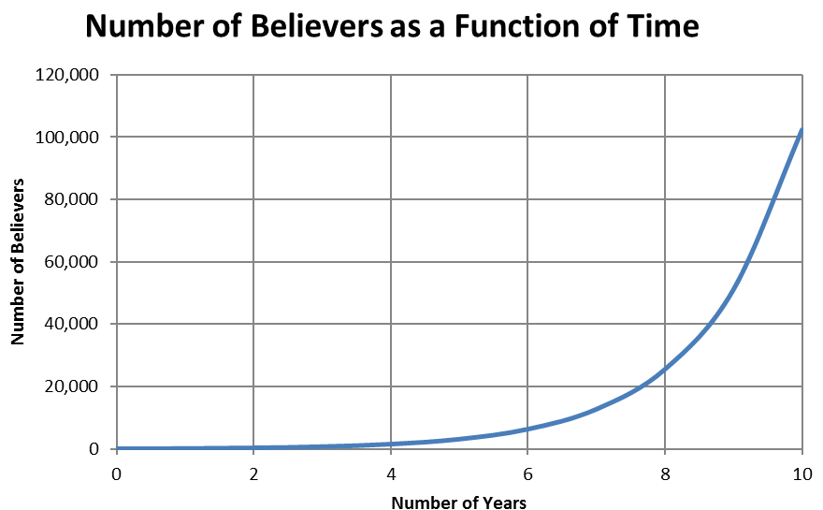
102,400 Believers
100 Believers

Slide 19
Closing Comments
Go to IDTEXPO.com and set-up a profile
Life is very much about relationships and harnessing the power of connections
Actively share your faith
As a Believer, God has gifted you – use those gifts and abilities to build a career and contribute to His Kingdom

Slide 20
Dr. Chris Alexander, PE
chris.alexander@advintegrity.com | (281) 450-6642 (cell)
Keep on keeping on!

