Slide 1
CEL
Engineering Professionalism

Slide 2
Big Rocks
Analogy from The Art of Manliness
Notes:
Joel

Slide 3
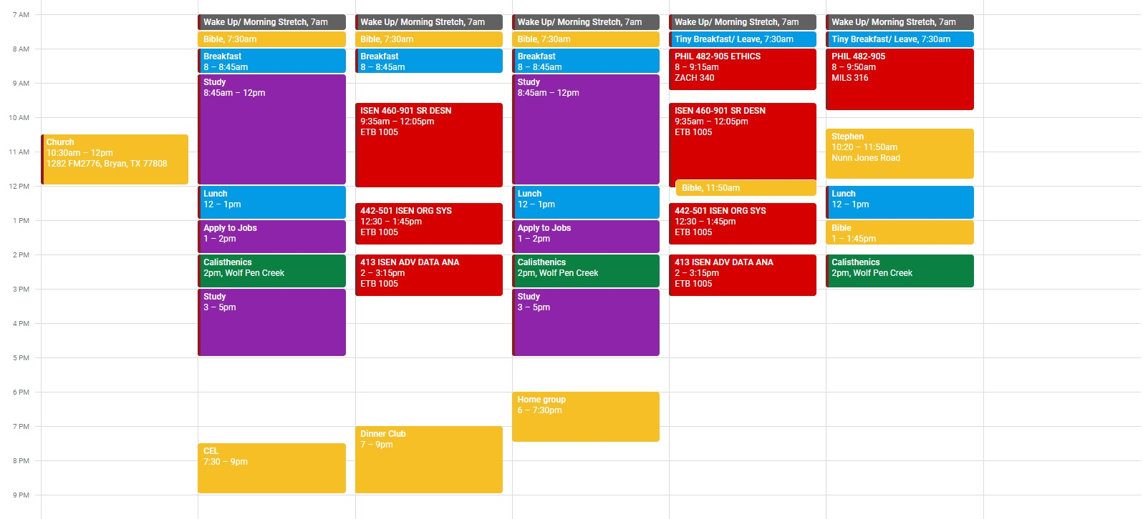
Productive
Unproductive
Notes:
Joel

Slide 4
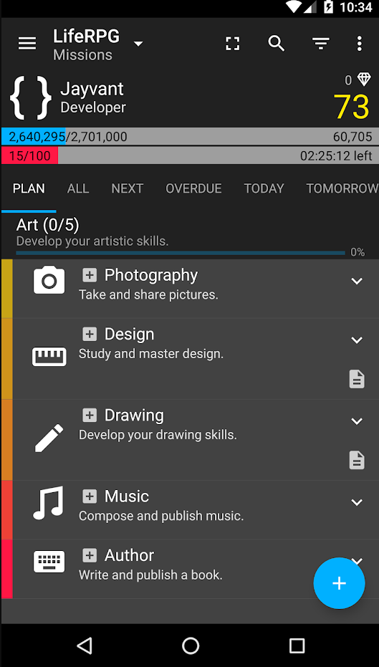
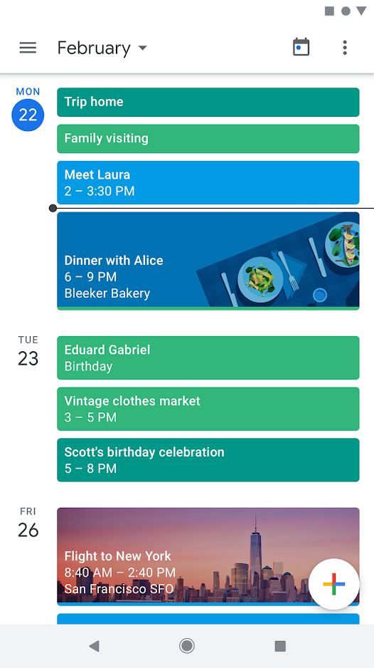
Productivity Apps

Slide 5
Time & Health Management

Slide 6
The Bible & Time Management
Time for Everything
Ecclesiastes 3:8 A time to love, a time to hate, a time for war, and a time for peace.
God has ultimate control
Psalm 31:15 My times are in your hand, rescue me from my enemies and from my prosecutors!
James 4:14 Yet you do not know what tomorrow will bring. What is your life? For you are a mist that appears for a little time and then vanishes.
Time management is wise
Proverbs 10:4 A slack hand causes poverty, but the hand of the diligent makes rich.
Psalm 90:12 So teach us to number our days, that we may get a heart of wisdom.

Slide 7
Food
FOOD PREP :)
Pack your lunch & eat it in an enjoyable place - academic plaza, garden on top of Zachry, top of architecture building
Eating healthy makes you feel better & be more productive!
White meat & fish
Vegetables: salads, microwave your broccoli & green beans
Snacks: carrots, apples, peanut butter

Slide 8
Exercise
Endorphins trigger a positive feeling in the body, often described as "euphoric." That feeling, known as a "runner's high," can be accompanied by a positive and energizing outlook on life.
Choose to jog or bike the long way to your classes - it can be fun to go on a little bike ride around a pretty part of campus between classes
Work out at the best time for you to feel accomplished & excited throughout the day (mornings or evenings)
Do SOMETHING every day, even if it’s small - push ups to help you wake up? Maybe go with a friend! Multitask with studying or watching something :)

Slide 9
Sleep
It is worth prioritizing this. Do not compare how much sleep YOU need versus how much your friends need.
Get the amount of sleep you need to be HIGHLY productive MOST of the day
At least 7 hours every night is good
On test nights, extra sleep is especially necessary
Heroic Minute
Sleep with a journal next your bed to write down lingering thoughts.
Have your phone in a different room than your bedroom.
Delete apps from your phone if they become too distracting.

Slide 10
Money Management

Slide 11
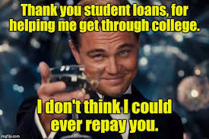
Paying for College
Loans: NOT FREE MONEY!!!
A loan is money you borrow and must pay back with interest
* Things to know:
- who is making the loan
- terms and conditions of the loan
Scholarships: FREE MONEY!!!
A scholarship is simply a company or individual providing financial assistance to you
* Things to know:
- minimize the white space in application
- fill in all areas
- get a person to proofread essays
Scholarship app link: https://www.cappex.com/

Slide 12
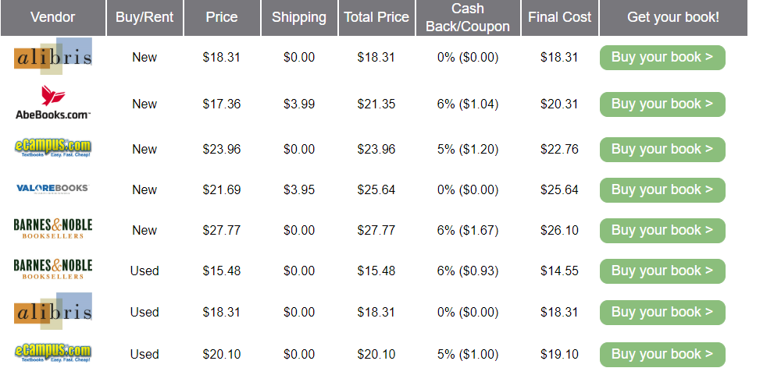
Textbooks
If you only need a textbook for one semester, try renting it
If you need a textbook related to your major, it may be best to purchase it
Consider using older editions of textbooks for subjects that don’t frequently change (potentially risky)
The Library can be a great resource for free materials
Ebooks/Papier Copies
Use price comparison sites - StudentRate/SlugBooks
Additional sites:
Textbook solutions
Cheapesttextbooks.com

Slide 13
Money Management & Personal Finance
Make a budget ------> Use said budget
Don’t spend money you don’t have
If you struggle with that might want to avoid credit cards
Budget templates are available
Remember: Taxes are a thing
God calls us to be obedient and tithe - strongly recommend
Resource: Dave Ramsey
Have a safety net (~3 months of expenses) easily accessible (bank, not investments)
Every Dollar

Slide 14
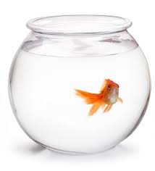
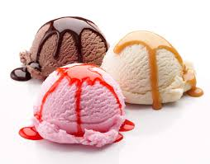
Liquidity-
how quickly something can be turned into cash
Physical Assets
Bank Account/Cash
=Very Liquid
Bonds
Investments
Boat
Car
Land
*gold*fish
Get it, haha
Stocks

Slide 15
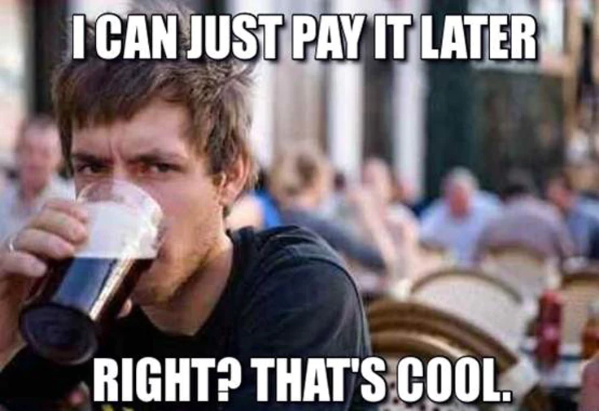
Credit Cards
Double edged sword
Good to build credit while in college
It’s NOT free money though
You should ALWAYS ALWAYS pay off your whole balance to avoid ridiculous fees and charges
Treat it like a debit card ⇒
No money, no spendy
Cool incentives, like 5% cashback!

Slide 16
Investing Tips
Disclaimer: We are not investing experts
Investing is all about Risk v. Reward
There is no get rich quick scheme
People who tell you so are liars
You win some, you lose some
Figure out how to win more than you lose
Investments don’t just go up over time
You have to keep and eye and adjust over time
Time is your biggest asset
The power of compounding
Start while young, even if it’s just a little bit
Look into starting a Roth IRA

Slide 17
Investing Resources
Disclaimer: We are not investing experts
Retirement presentation by CSCE department
https://1drv.ms/p/s!AuT9n-7S9WEvhfkQQvj1CZyWoKIbVg
Investopedia
Great place to learn the basics of investing
Seeking Alpha
Market news and world events affecting the markets
Real Investment Advice
More in depth market analysis for individuals with more of a background

Slide 18
Questions???

